Slide 1
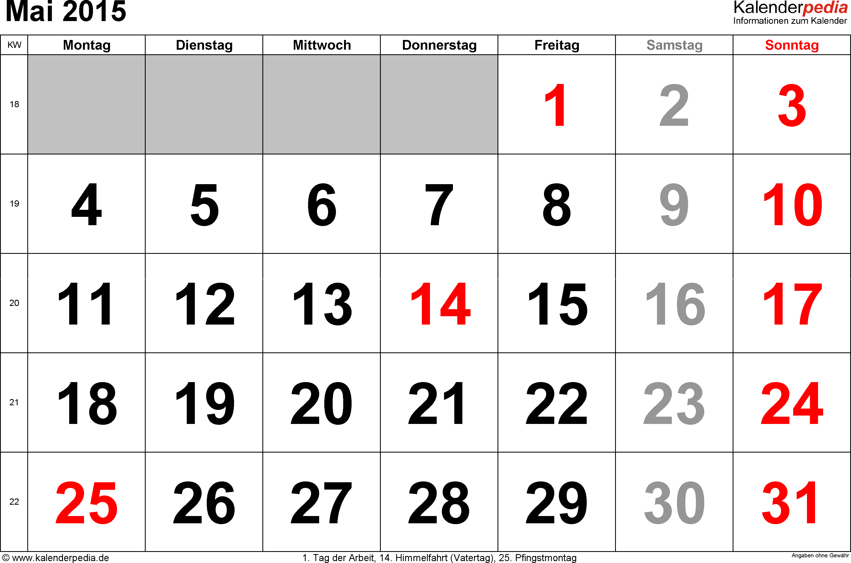
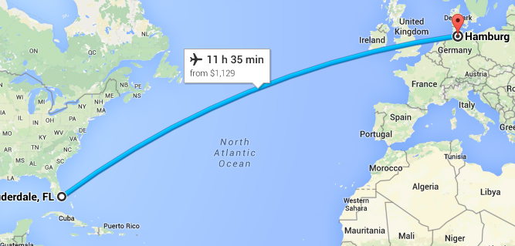
To Germany May 31-July 25

Slide 2
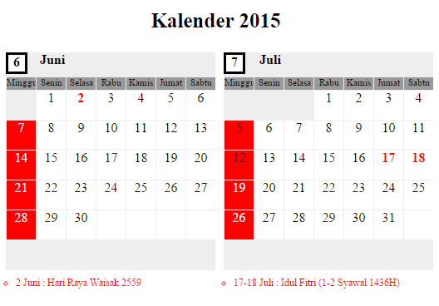
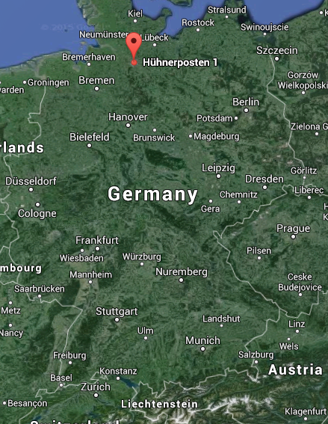
Hamburg:
Goethe Institute
(Bunde)

Slide 3
Rostock (Sweden)

Slide 4
Either Rostock or Berlin

Slide 5
Berlin: Goethe Institute

Slide 6
Munich/Austria

Slide 7
Hamburg/nach Hause

